Slide 1
Monday, we talked about the inequality of climate change, today, we explore our personal connection to climate change

Slide 2
Why start with personal connections?
From climate communication sciences:
Many people do not talk to others about climate change for a variety of reasons
Afraid to be in the minority opinion, creating conflict, lack confidence, etc.
Notes:
All the baggage that we carry can affect how we think about and learn about climate science

Slide 3
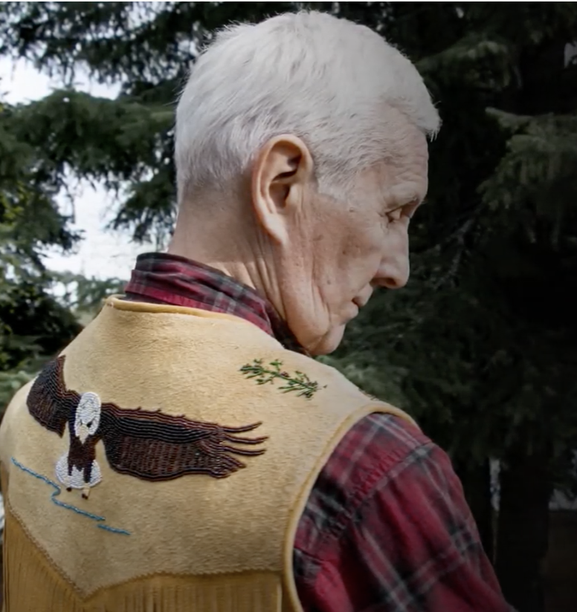
Personal experiences are hard to deny and easy to talk about
From climate communication sciences:
You may not be a “climate expert” but you are the expert on yourself. Say what you think and tell your story.
Stories are a powerful means to connect with others on shared values and experiences.
“What you observe is truth.”
-Elder Sam Demientieff
Notes:
Start with our personal story, cultures around the world have used stories for an exceptionally long time
Elder Sam Demientieff is Athabascan

Slide 4
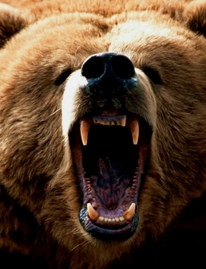
Why connect on experience?
Humans have a hard time perceiving and responding to slow moving, uncertain, and abstract threats.
Many people, perceive that climate change is distant and affects plants, animals, people in the future or in far off places.
Connecting your experiences brings climate change to the here and now and us.
Family, community, and organizations that matter to us, can help to connect us to the time and geographic scale of climate change.
In general, humans are much better at perceiving and responding to threats like this!
Notes:
Kristin

Slide 5
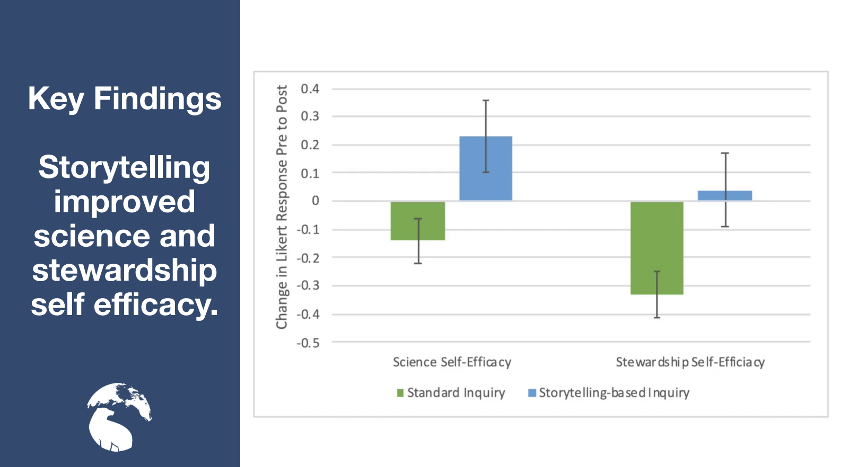
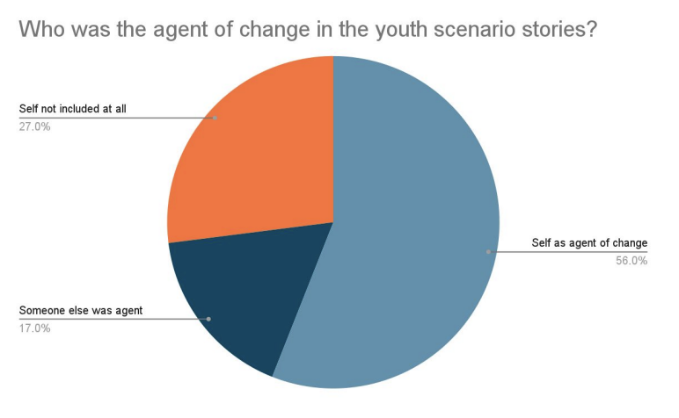
The power of stories
From climate education research:
Stories paired with climate science enhance learning!
Stories allow us to picture ourselves in the climate system as agents of change.
Spellman et al. 2021 Frontiers in Ecology and Evolution
Notes:
In Spellman et al.’s study (friend and learning researchers), youth who participated in a citizen science berry project used storytelling to communicate the data they collected in their classes. Youth who participated in storytelling-based inquiry had both higher science self-efficacy (ability and confidence to perform tasks related to science) and stewardship self-efficacy (ability and confidence to take on stewardship roles and actions)
Half of the students (from youth to college) just did the science (berry accounts) and learned about storytelling, collected data, and created stories. Participants were also more likely to see themselves as agent of change and as part of the climate system.

Slide 6
Dialogue Agreement
In Every Chair, A Leader
Speak with Care for Others
Value Each Others Time
Listen Deeply
Safe Space for Meaningful Conversation
Our Value of humor
Be Present and Engaged
Take Care of Yourself, Take Care of Others
Allow Disagreements to Happen
Others?
Credit: First Alaskans Institute
Notes:
In Every Chair, A Leader Each person engaging in this conversation has a unique and valuable experience that is their truth.
Speak with Care for Others We each hold the responsibility to choose our words and questions carefully with the intent to learn.
Value Each Others Time We all share the responsibility to ensure that everyone has an opportunity to speak and engage.
Listen Deeply This is a rare and valuable opportunity to connect with others through the sharing of life experience.
Safe Space for Meaningful Conversation All notes taken are non-attribution to ensure anonymity of all dialogue participants.
Our Value of Humor Laughing is also an important way to relate with one another.
Be Present and Engaged Cell phone ringers off, be mindful of being fully present and listening.
Take Care of Yourself, Take Care of Each Other Note restrooms, exits, other amenities. Ask that participants help one another when possible.

Slide 7
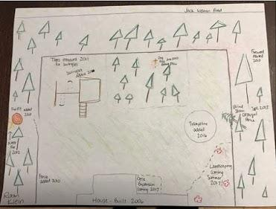
Mapping a Personal Story of Climate Change
ABOUT THIS ACTIVITY
ENDURING UNDERSTANDING:
Climate change influences our lives.
ESSENTIAL QUESTION:
What changes have I observed in my own life that may be related to climate change?
Lesson written by Dr. Katie Spellman, University of Alaska Fairbanks International Arctic Research Center, with input from Dr. Elena Sparrow and adapted from an activity first developed by Naomi O’Neal. Funding for development of the Arctic and Earth SIGNs project materials is provided by NASA under Award No. NNX16AC52A. Any opinions, findings and conclusions or recommendations expressed in this material are those of the authors and do not necessarily reflect the views of the National Aeronautics and Space Administration. It is one of the projects within the NASA Science Mission Directorate's Science Activation to further enable NASA science experts and content into the learning environment more effectively and efficiently with learners of all ages.
Notes:
Katie

Slide 8
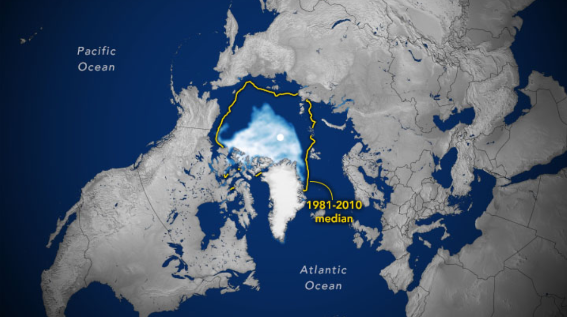
Maps tell stories
Source: NASA Earth Observatory
Notes:
Sea ice minimum extent in 2020 compared to the historic 1981-2010 median

Slide 9
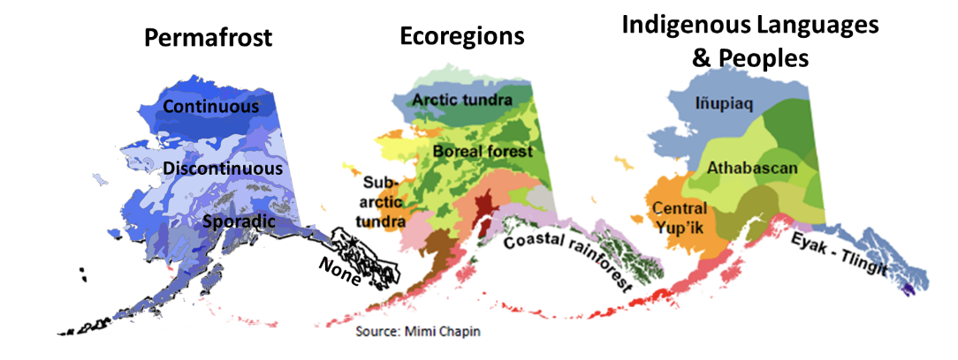
Maps tell stories

Slide 10
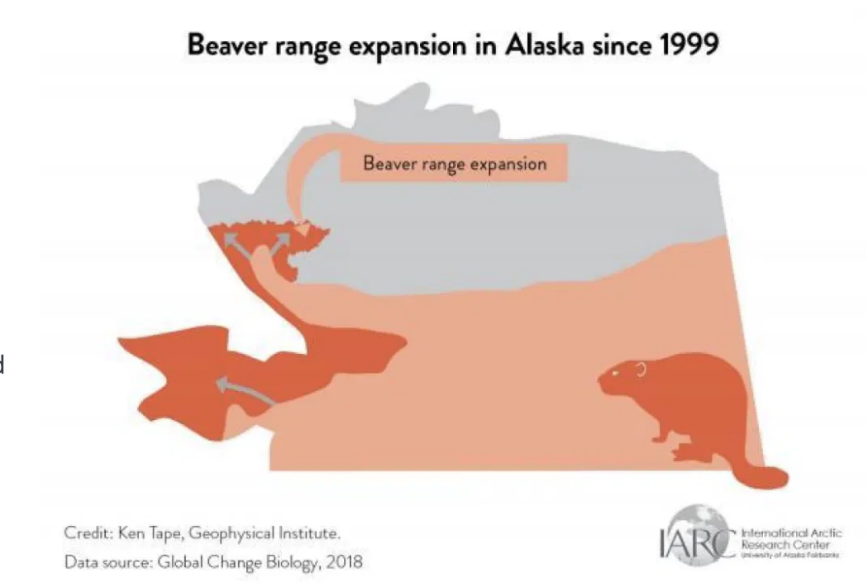
Maps tell stories

Slide 11
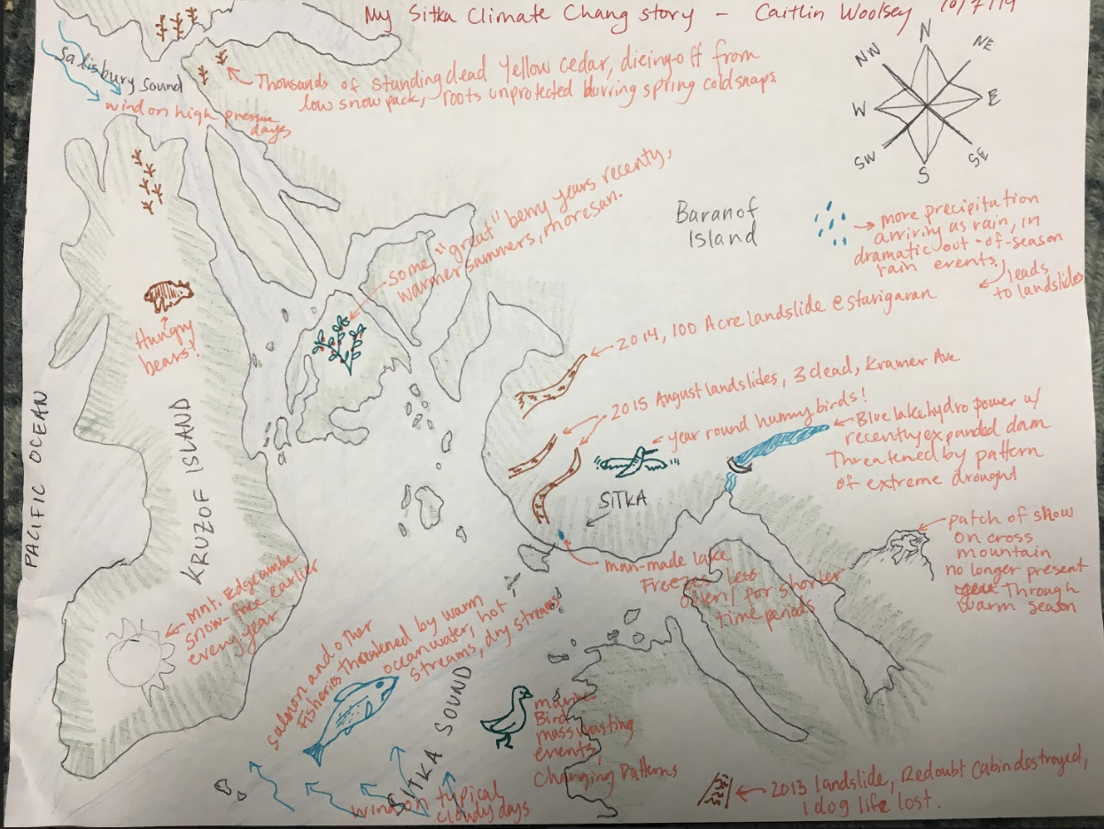
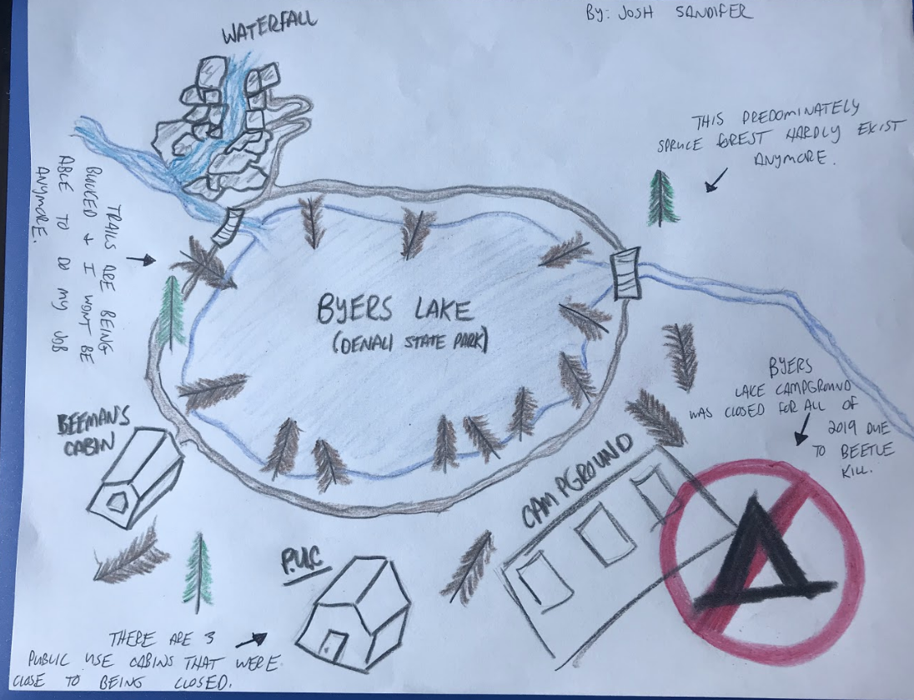
Activity Instructions
1. On a piece of paper, sketch a map of a place you know really well. It could be anywhere that you have a strong connection with—your town, your house, your favorite beach, the loop you walk your dog on, the park you grew up playing in—someplace you know really well.
2. On the map, draw social and ecological changes that you have observed in that place that you think could be related to a changing climate. You can represent these in any way you want.
3. You have 20 minutes to sketch your map.

Slide 12
Breakout Groups
Share your map. Be mindful of time and no one person should share for longer than 3 minutes.
Look for trends across the people in your breakout group. Were there similar topics that kept coming up? Similar emotions? Shared values? Be prepared to share the trends across the maps in a full class discussion.

Slide 13
Trends in our Observations
O’ahu changes
Sea level rise and ocean acidification
Precipitation, frustration, sadness
Water level, erosion
Wildfires, smoke, lack of precipitation
Loss of snow, excessive ice storms
Changes in precipitation (more snow, less snow, all change)
Water levels, erosion (beaches and trails)
Temperature changes, water loss, more drastic changes

Slide 14
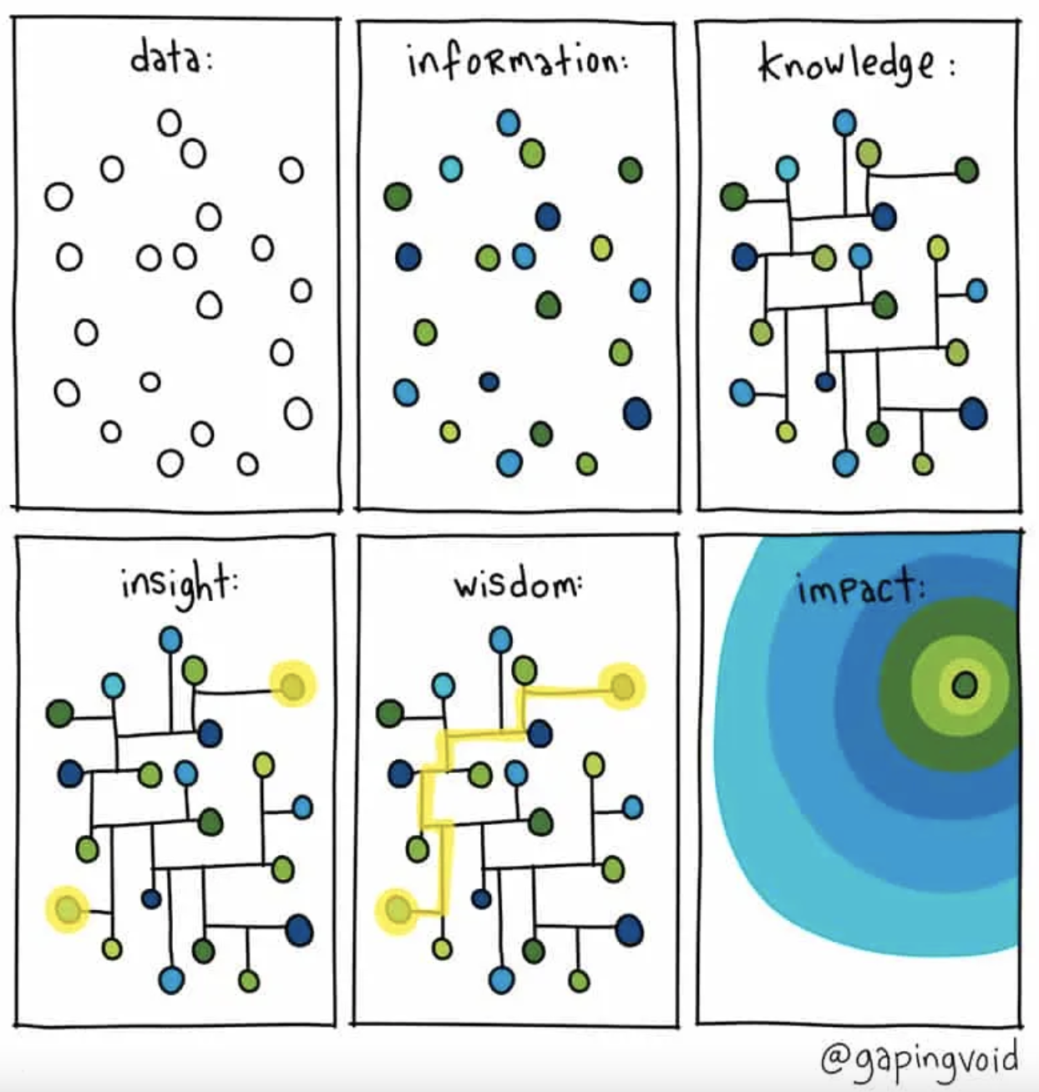
Observations
To Impact

Slide 15
Friday, we will learn theory and skills around having conversations about climate change. Then, we will practice!

